Slide 1
Trends in
Georgia
Population
Analyzing Population Changes in Georgia Counties as affected by the COVID Epidemic
Notes:
Good evening,
The peach state is one of the fastest growing states in the US. Our group has decided to study how covid has affected the population growth. And we are doing so by using the cencus release estimate over the years.

Slide 2

Outline
Presentation Agenda
Background
Marie Sanon
Analysis
Yi Huang
Jesse Perez
Conclusion
Jesse Perez
Notes:
Our presentation will consist of presenting the background which will be done by me.
Yi and Jesse will present the analyisis.

Slide 3

Background
Claim - The COVID epidemic has caused a significant shift in Georgia’s counties, trending away from urban and towards rural counties. Since the start of COVID (3/2020), the growth rate of rural counties has exceeded that of urban counties.
Null Hypothesis (H0): Rural Population Growth <= Urban Population Growth
Alternate Hypothesis (HA): Rural Population Growth > Urban Population Growth
Notes:
Popular belief will suggest that the pandemic would have tremendously affected GA counties population. We expect that there will be a shift of population from urban towards rural counties. We think that with every ailment covid brought the rate of rural counties has surpassed that of urban ones.
Our hypothesis is that rural population grew more than that of urban ……

Slide 4


Approach
Gather Georgia County census data over last decade to get idea of general trend/pattern.
Randomly select 10 counties for closer analysis
Formulate a growth rate by year and county for analysis
Designate counties as either urban or rural based on population
Plot and analyze patterns across data sets(plots)
Create a heat map to visualize trends(maps)
Notes:
In order to prove our hypothesis we took our cencus data and downloaded csvs. Since we have such a large number of counties we decided to select 10 random counties to analyze them. From these data we wil formulate a growth rate by year and ccounties. We used plots to analyze patterns across data sets and to finish we created a heat map to vizualise the trends before and after covid.

Slide 5
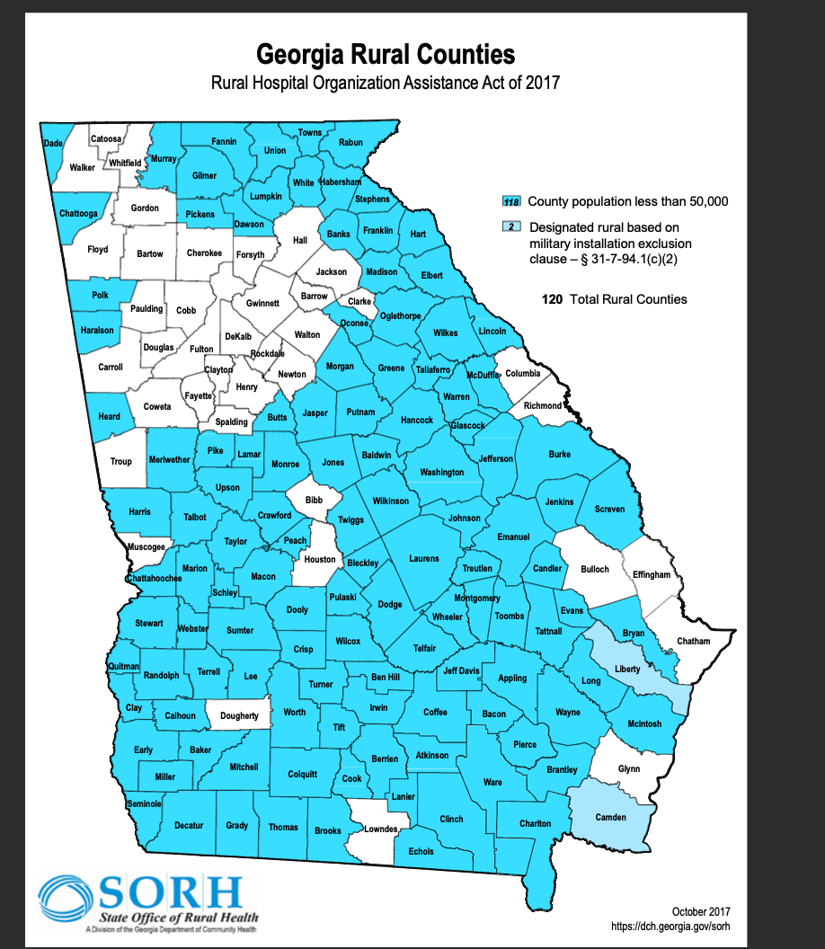
Definition of Terms
Urban v Rural
Georgia’s Department of Community Affairs (DCA) established a population cutoff of 50,000 people to categorize counties as either Rural or Urban
Total Counties = 159
Rural = 120
Urban = 39
COVID Start Date in Georgia
First cases identified March 2020 per GA Department of Health
Notes:
2020 will be considered our COVID start year. Rural countries are defined by the state office of rural health as counties with a population of less than 50k. This map shows that ga has a total of 159 countes which 39 are urban and 120 rural. In those 120 2 are designated rural based on military installation.
On March 23, Atlanta mayor Keisha Lance Bottoms signed a 14-day stay-at-home order to direct all city residents to stay at home except for performing essential tasks through April 7.

Slide 6
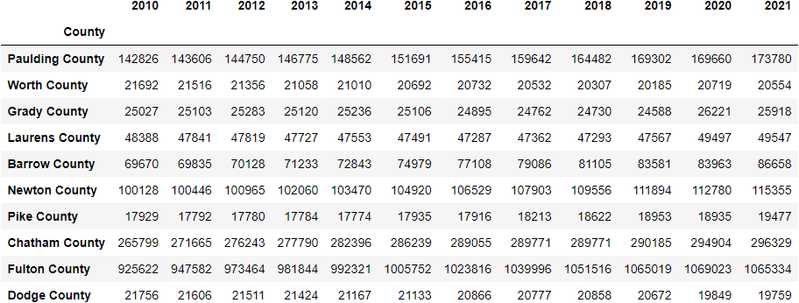
Randomly Selected GA Counties
= Urban Counties
Source: U.S. Census Bureau, Population Division
Notes:
10 randomly selected counties out of 159 counties. The couties selected in green are the one with a population greater than 500 k. Here we see that fulton county is the largest one with a million people approximately.
I will turnover to yi

Slide 7
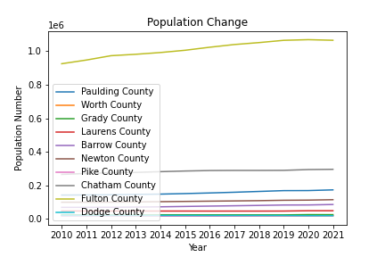
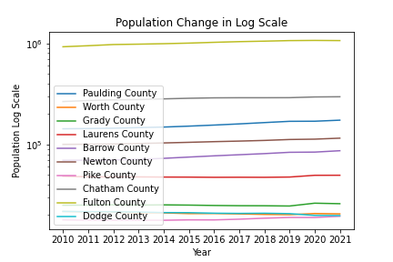
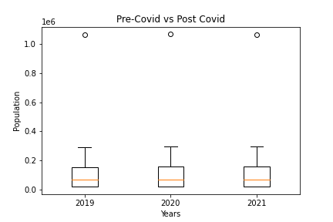
Notes:
here’s what it looks like graphed.

Slide 8
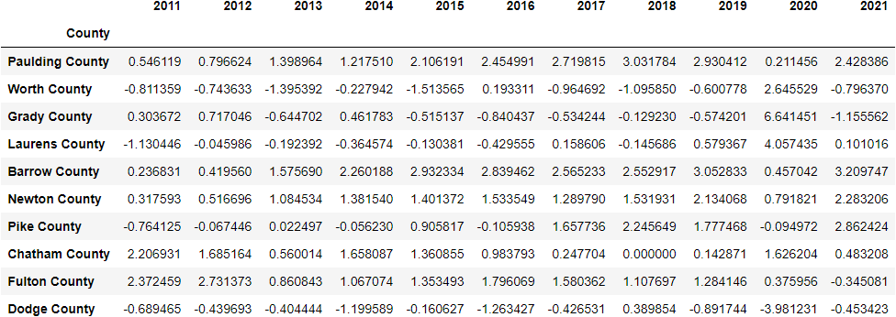

% Change of Randomly Selected GA Counties
Notes:
size isn’t everything. we should look at the relative change from year to year

Slide 9
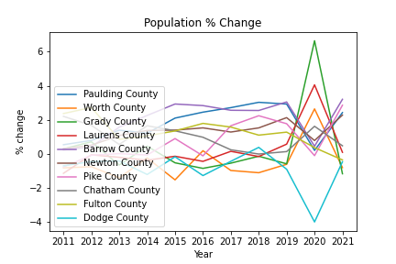
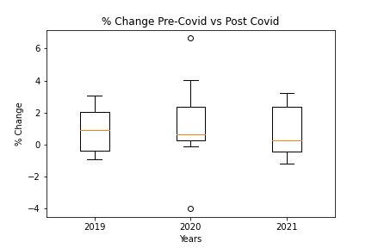
Notes:
here is what that table looks like graphed. bit of a mess…

Slide 10
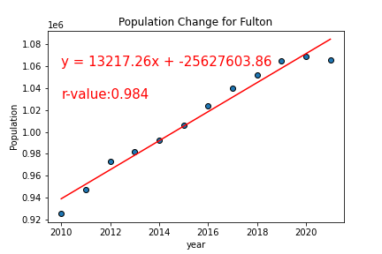
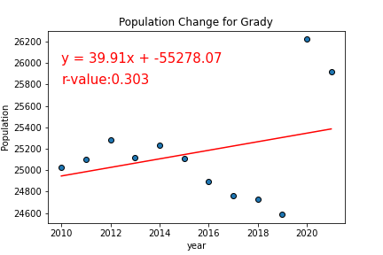
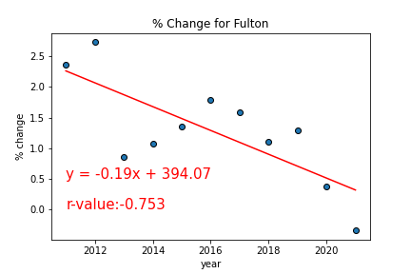
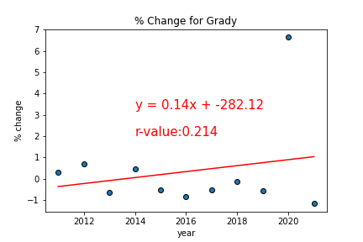
Notes:
very high r-value for pop change. though rate of change is decreasing.

Slide 11
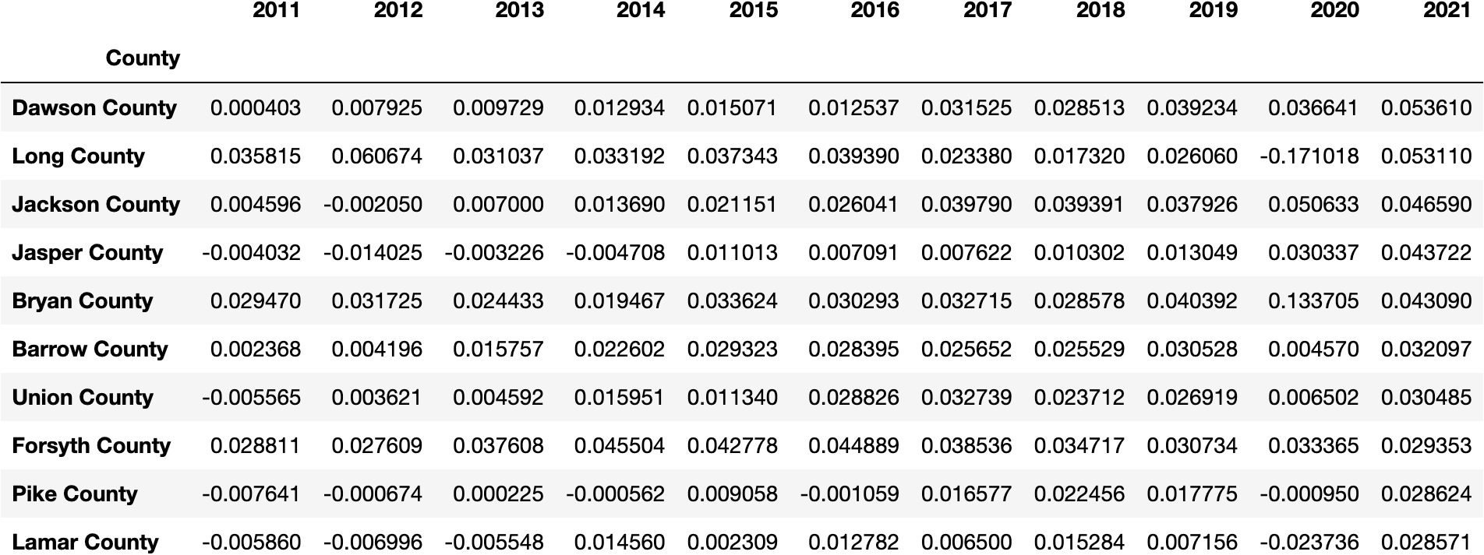
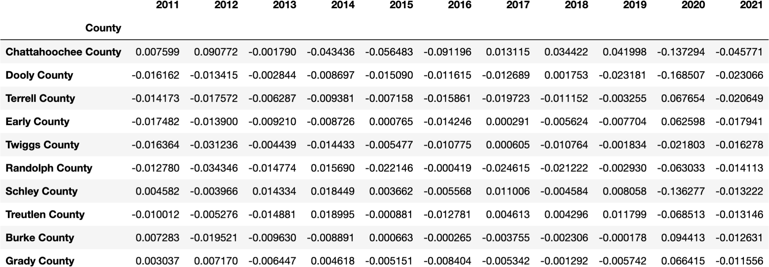
Top VS Bottom Performing Counties
Top 10
Bottom 10

Slide 12
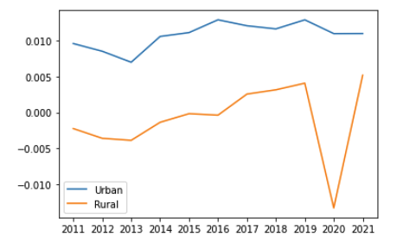
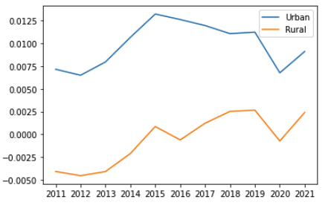
Urban v Rural
Average
Median

Slide 13
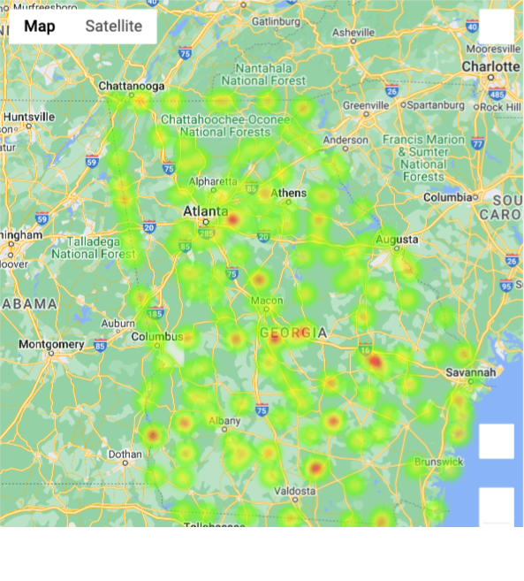
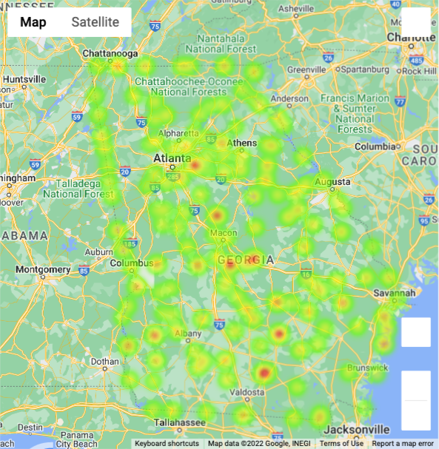
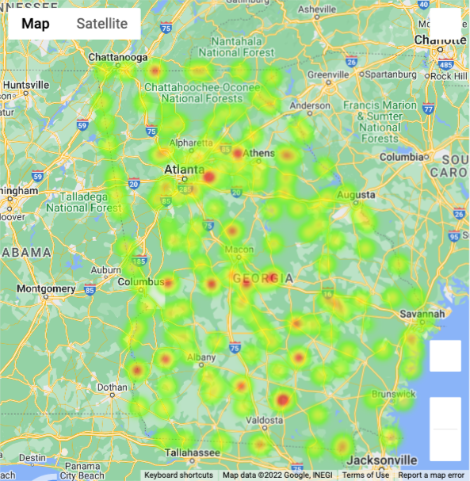
Heatmaps
2019
2020
2021

Slide 14
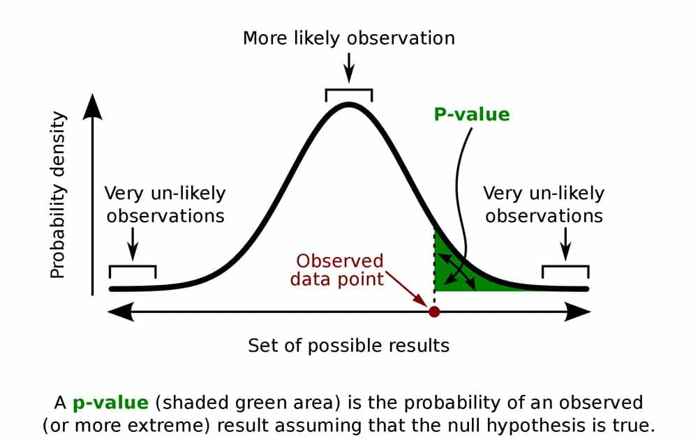
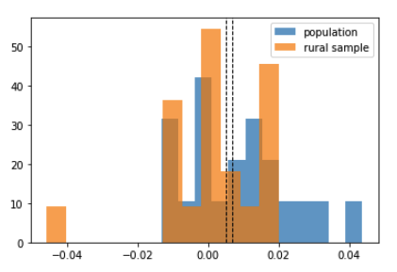
CONCLUSION
Analyzing Rural Population Growth samples against the mean growth rate, we conclude that COVID has not caused a population surge in rural counties.
Our null hypothesis has been accepted and our alternate hypothesis rejected. The growth rate of rural counties did not exceed the average growth rate of Georgia counties in either 2020 or 2021.
Ttest_1sampResult(statistic=-0.41347072821689096, pvalue=0.6889399579094846)
image source: simplypsychology.org
 | 2019 | 2020 | 2021
Rural | 0.41 | -1.33 | 0.52
Urban | 1.29 | 1.10 | 1.10
All | 0.64 | -0.70 | 0.67

Slide 15




Slide 16
Resources
Census Data:
https://www.census.gov/data/tables/time-series/demo/popest/2020s-counties-total.html
Georgia Rural Counties:
https://dch.georgia.gov/document/document/georgia-rural-counties-map/download
Geographical features:
https://eric.clst.org/tech/usgeojson/
Georgia COVID Information:
https://dph.georgia.gov/covid-19-status-report
P.value:
https://www.simplypsychology.org/p-value.html
Additional libraries:
numpy, pandas, random, datetime, matplotlib.pyplot, and scipy.stats (for linear regression – linregress)

Slide 17
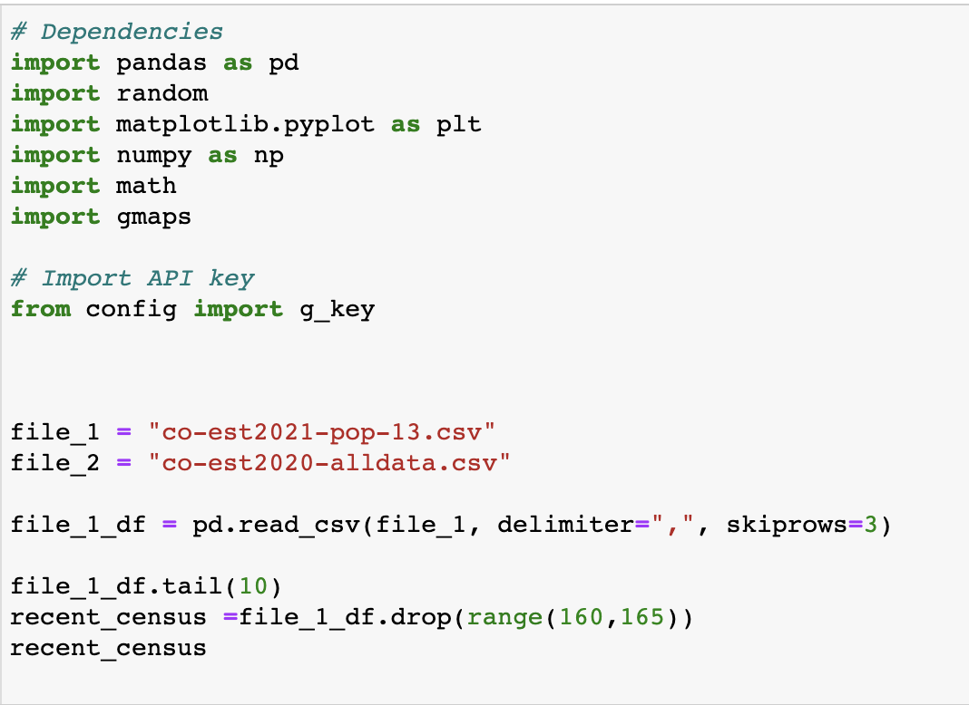
CODE (1) - Dependencies

Slide 18
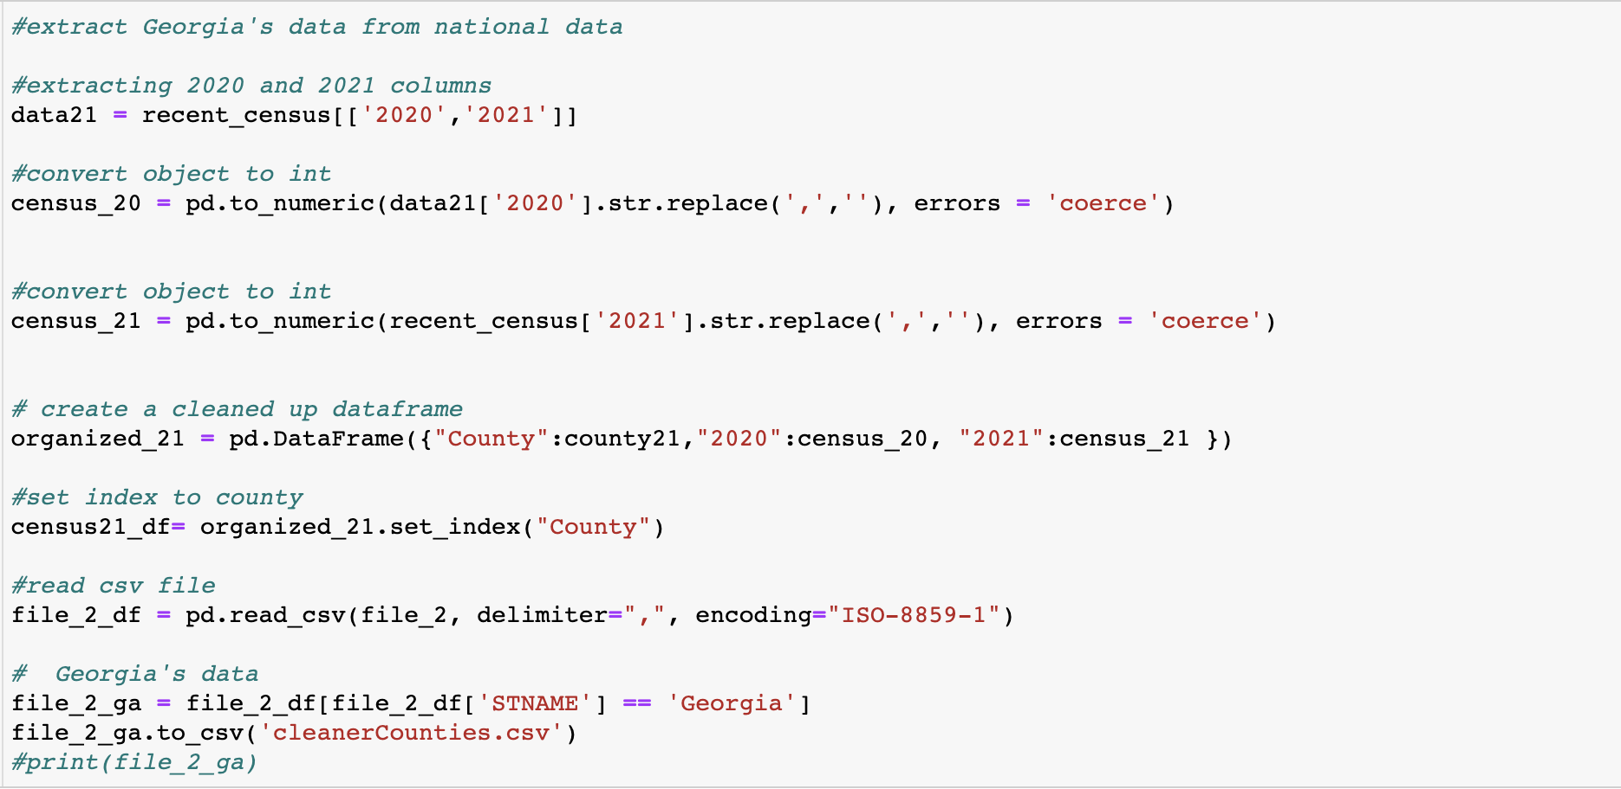
Code (2) - Cleaning our Data, Extracting Georgia Data from Nation

Slide 19
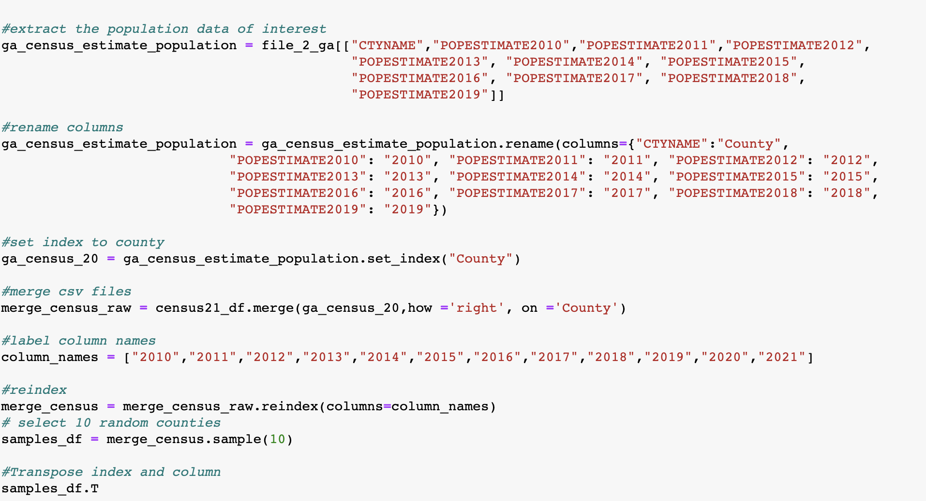
Code (3) - Data Cleaning and Getting Sample

Slide 20
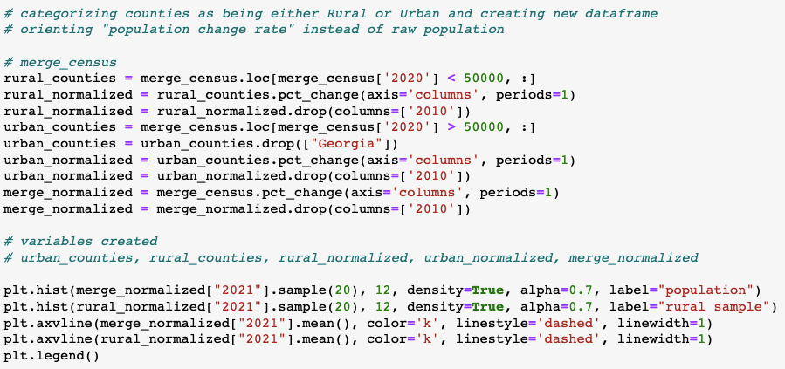
Code (4) -Plotting changes in Population by Counties

Slide 21
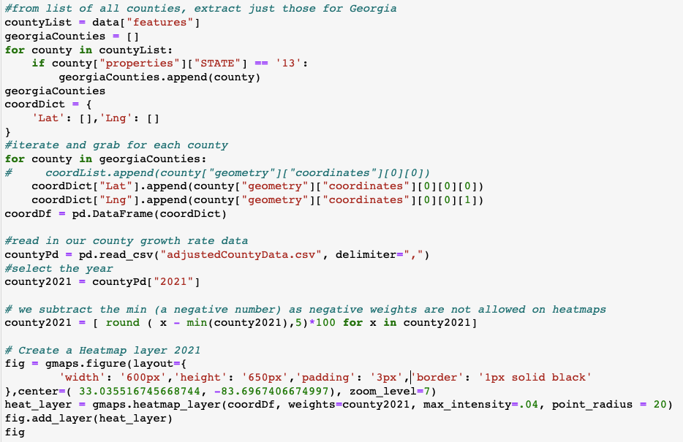
Code (4) - Plotting Growth Rates as Heatmaps

Slide 22
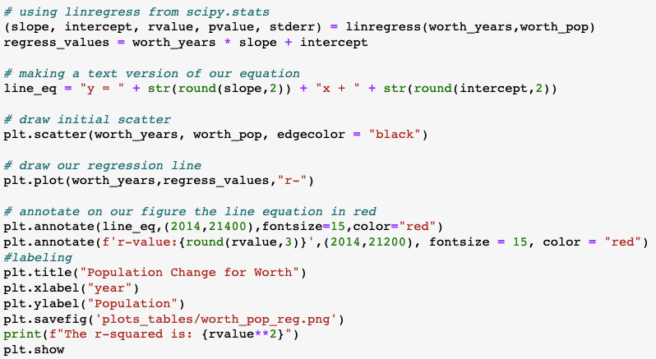
Code (5) - Generating Linear Regression and Plotting

